Slide 1
Orthopedic Infections: A Clinical Pharmacy Perspective
Ahmed M. Sayed
Assistant lecturer
Department of Orthopedics and Trauma Surgery

Slide 2
Definition of Osteomyelitis
Definition: Inflammation of bone and bone marrow caused by an infecting organism.
Classification:
  Acute (<2 weeks)
  Subacute (2-6 weeks)
  Chronic (>6 weeks)

Slide 3
Acute Osteomyelitis – Key Organisms
Common Pathogens:
  Staphylococcus aureus (MSSA, MRSA) >>> MC 90%
  Others: Streptococcus species, Gram-negative organisms (E. coli, Pseudomonas)
  Unusual: Salmonella (in sickle cell anemia patients), pseudomonas in IV addicts and wounds

Slide 4
Acute Osteomyelitis – Risk Factors
Endogenous: Diabetes, sickle cell disease, malnutrition, immunosuppression, obesity, smoking, systemic infections
Exogenous: Trauma, surgery, foreign implants.

Slide 5
Acute Osteomyelitis – Sites
Children:
  Metaphysis (mainly around knee)
Adults:
  Spine

Slide 6
Acute Osteomyelitis – Route of infection
I. Hematogenous spread
II. Local spread
III. Direct inoculation

Slide 7
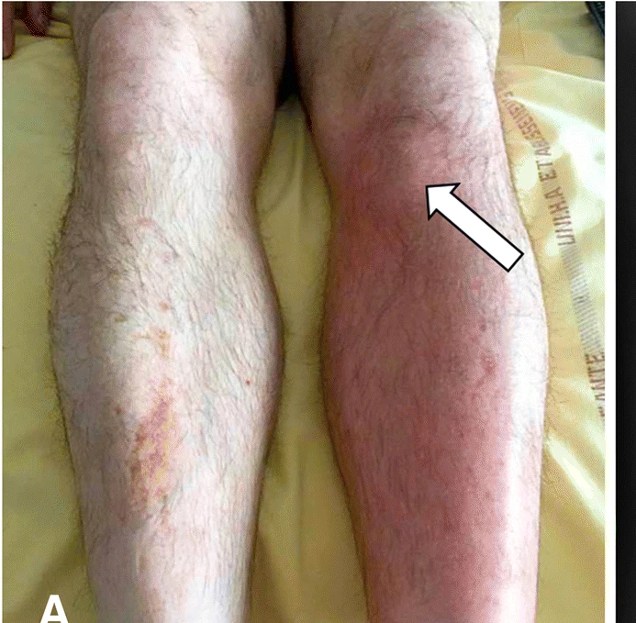
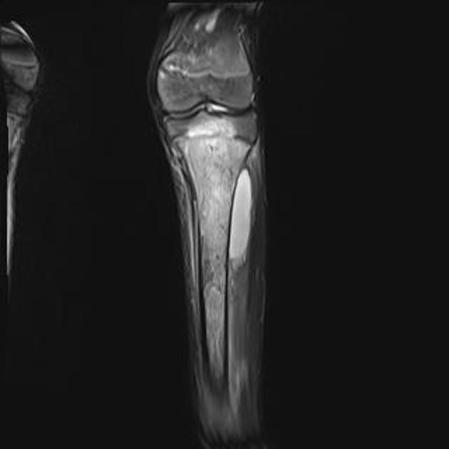
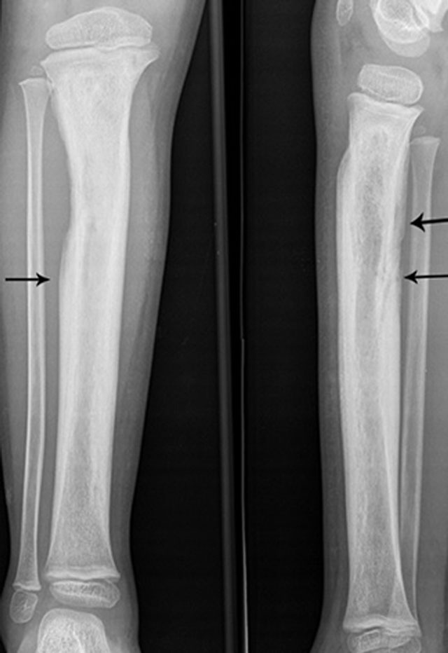
Acute Osteomyelitis – Clinical Presentation
Symptoms: Fever, localized pain, swelling, tenderness.
Lab Findings:
  ↑ WBC, ESR, CRP
  Blood cultures (positive in 50% of cases).

Slide 8
Acute Osteomyelitis – TTT
1- General supportive treatment:
  • Bed rest, Fluids.
  • Analgesics, Anti-inflammatory.
2- Splintage:
  • Skin traction or slabs
  Helps to  pain, contractures
3- AB
4- Operative treatment
  Failure to respond to medical treatment
  Subperostieal abscess
  Pus on aspiration
  Chronic infections

Slide 9
Acute Osteomyelitis – Antibiotic Therapy
Empirical Therapy:
  MSSA: Nafcillin, cefazolin, clindamycin.
  MRSA: Vancomycin, linezolid.
  Gram-negative: 3rd-gen cephalosporins (ceftriaxone), fluoroquinolones.
Duration: 4-6 weeks (IV + oral).

Slide 10
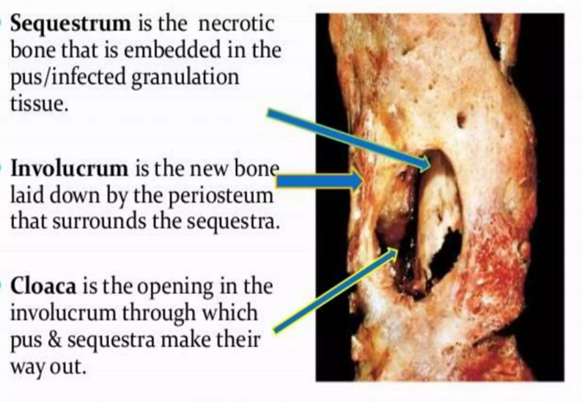
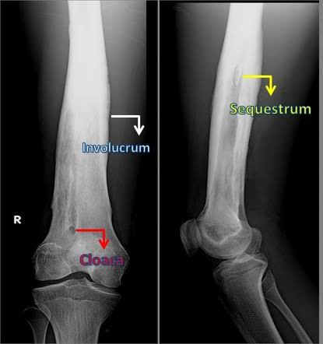
Chronic Osteomyelitis – Treatment
Key Principles:
  Usually occurs as a sequel to acute hematogenous, postoperative or post-traumatic OM.
  Cavities containing dead bone spicules (Sequestra) that may act as a media for bacterial adhesion
  Surgical debridement + antibiotic therapy.
  Antibiotics: Tailored to culture results.
Duration: 4-6 weeks.

Slide 11
Septic Arthritis – Overview
Definition: Purulent inflammation of synovial membrane within a joint.
Common Pathogens:
  Staphylococcus aureus (most common).
  Streptococcus species, Gram-negative organisms.
Treatment:
  Surgical emergency!!!!!!!

Slide 12
Pyogenic Vertebral Osteomyelitis (PVO)
Common Pathogens:
  Staphylococcus aureus (50%).
  Gram-negative organisms (E. coli, Pseudomonas).
Treatment:
  Empirical Therapy: Vancomycin + ceftriaxone.
  Duration: 6 weeks.

Slide 13
Tuberculous Osteomyelitis – Pott’s disease
Pathogen:
  Mycobacterium tuberculosis (acid-fast bacillus).
Pathology:
  Granuloma formation with caseation necrosis.
  Cold abscess formation (may drain via sinuses)

Slide 14
Tuberculous Osteomyelitis - Clinical Presentation:
Systemic Symptoms: Night sweats, fever, weight loss, malaise.
Local Symptoms:
  Back pain (most common symptom).
  Spinal deformity (kyphosis, gibbus deformity).
  Neurological deficits (if spinal cord compression occurs).
Investigations:
  Lab Tests:
    Tuberculin Skin Test (TST): Positive in active or past infection.
    Interferon-Gamma Release Assays (IGRAs): More specific than TST.
  Imaging:
    X-ray: Vertebral destruction, disc space narrowing, kyphosis.
    MRI: Paravertebral abscess, spinal cord compression.
    CT-guided biopsy: Confirms diagnosis (acid-fast bacilli on smear or culture).

Slide 15
Tuberculous Osteomyelitis - TTT
First-line Drugs:
  Isoniazid (INH): 5 mg/kg/day (max 300 mg).
  Rifampin: 10 mg/kg/day (max 600 mg).
  Pyrazinamide: 15-30 mg/kg/day (max 2 g).
  Ethambutol: 15-25 mg/kg/day.
Duration:
  Intensive Phase: 2 months (INH + rifampin + pyrazinamide + ethambutol).
  Continuation Phase: 4-7 months (INH + rifampin).
Monitoring:
  Liver function tests (LFTs) for hepatotoxicity (INH, rifampin, pyrazinamide).
  Visual acuity for ethambutol-induced optic neuritis.

